Slide 2
Continental Drift

Slide 4
The first thing we need to find out is what an earthquake is.
What we observe is:
•Movements that produce earthquakes are usually associated with large fractures in Earth’s crust called faults.
•Most of the motion along faults can be explained by the plate tectonics theory.
•Earthquakes can be caused by faults, the motion of magma,
and explosions (e.g volcanoes or nuclear bombs)

Slide 5
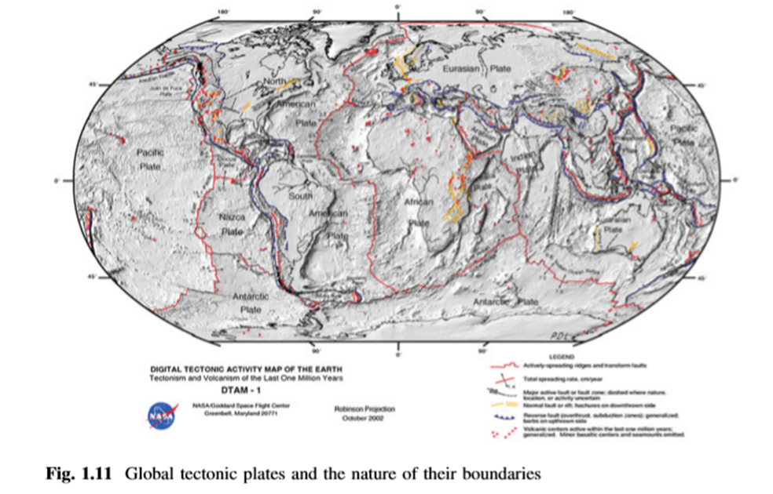

Slide 6
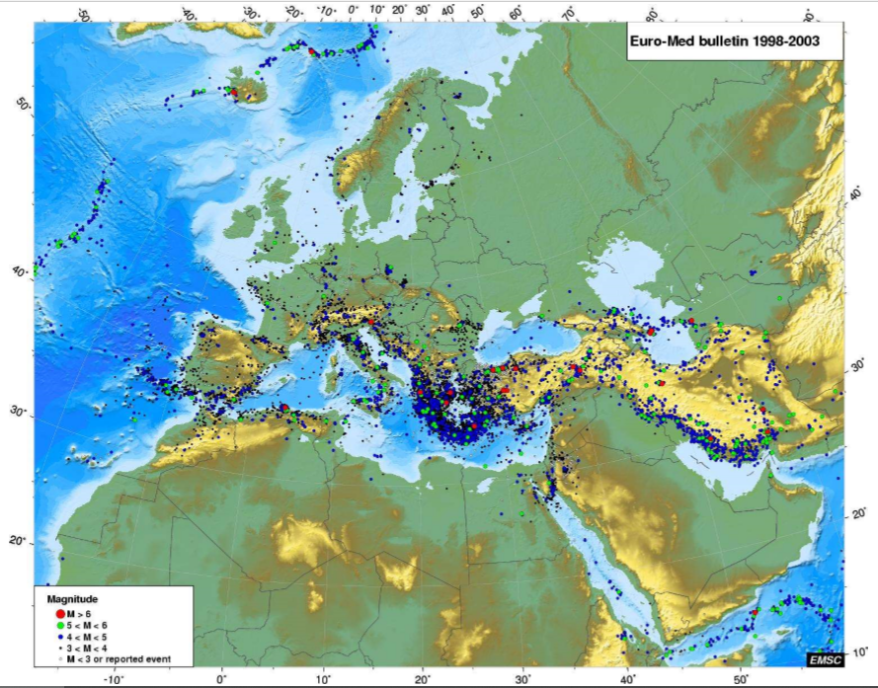
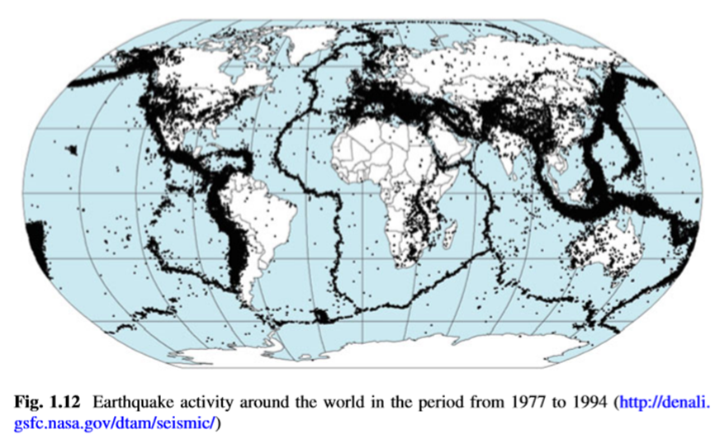

Slide 7
Elastic Rebound Theory
Elastic rebound appears to be the primary mechanism of earthquakes.
During the process of elastic rebound:
•Slippage at the weakest point (the focus) occurs after buildup of strain.
•Vibrations (earthquakes) occur as the deformed rock “springs back” to its original shape (elastic rebound). Then the entire process is repeated when the strain builds up again.
Earthquakes most often occur along existing faults whenever the frictional forces on the fault surfaces are overcome.

Slide 11
So…. Exactly what is an earthquake?
An earthquake is the vibration of Earth, produced by the rapid release of energy.
•Energy released radiates in all directions from its source, the focus (see below).
• Energy is in the form of waves.
• Sensitive instruments around the world record the event.

Slide 12
Where do Earthquakes Originate?
Remember these definitions.
• Focus — also known as the hypocenter, it is the place within Earth where earthquake waves originate
• Epicenter —location on the surface directly above the focus

Slide 16
Body waves ‐ Body waves (travel through “body of rock”).
They travel through the Earth’s interior, and there are two types based on the mode of travel.
Primary (P) waves
•Pushpull (compress and expand) “back and forth” motion, changing the volume of the intervening material
•Very fast travel time (4 to 7 KM / Sec). Generally, in any solid material, P waves travel about 1.7 times faster than S waves.
•Travel through solids, liquids, and gases (almost any medium)

Slide 17
Secondary (S) waves
•“Shake” motion at right angles to their direction of travel .
The motion is Up/Down and Sideways which means
S waves vibrate perpendicular to the direction of propagation. A shear wave can be split into orthogonal, i.e., horizontal and vertical, components
• Slower velocity than P waves (2 to 5 KM / Sec.)
• Slightly greater amplitude than P waves
•Cannot travel through fluids (gases and liquids). They travel only through solids

Slide 18
Surface waves ‐ Travel along outer part of Earth and cause the most destruction.
• Their motion is complex
• Cause greatest destruction
•Exhibit greatest amplitude and slowest velocity (Slower than body waves)
•Waves have the greatest periods (time interval between crests)
•Referred to as L waves/Long waves/Love waves AND Rayleigh waves

Slide 19
» Love wave ?
Horizontal shear wave
»Rayleigh wave?
Retrograde/elliptical (ocean wave‐ like) particle motion.
This type has a large ground motion and cause much of the destruction in earthquakes

Slide 25
The Size of an Earthquake?
Intensity of Shaking (Robert Mallet, 1857)
Calculation of Earthquake Magnitude (Charles Richter, 1935)
In 1857, Robert Mallet produced isoseismal lines based on quantified damage levels.
In 1902 an Italian seismologist and volcanologist, G. Mercalli, developed an intensity scale
H.O. Wood and Frank Neumann modified tis scale which is now widely used as the abridged Modified Mercally Intensity Scale
Measuring the Size of Earthquakes ?
Two measurements that describe the size of an earthquake are:
Intensity: A measure of the degree of earthquake shaking at a given locale based on the amount of damage.
Magnitude:
Estimates the amount of energy released at the source of the earthquake

Slide 26
The body-wave (mb) and surface-wave (Ms) magnitudes are the two types of teleseismic magnitude scales. They are estimated from the seismic waveforms recorded by short-period (mb) and long-period seismograms (Ms).

Slide 27
The ﬁrst magnitude scale is proposed by Richter (1935) for quantifying the sizes of earthquakes in southern California from the maximum amplitudes (A in mm)

Slide 28
As the earthquakes become larger in size, they generate very long-period waves that reﬂect the seismic energy released by the ruptured fault.
The amplitudes of these waveforms cannot be detected properly by seismographs used for the computation of mb and Ms.
Thus, neither of these magnitude scales will be able to quantify the actual size of the earthquakes when they become larger.
In other words, the increase in earthquake size will not yield a consistent increase in mb and Ms as the corresponding seismographs will misrepresent the increase in the maximum amplitudes of very long-period waveforms.
This phenomenon is called as magnitude saturation (failing to distinguish the size of earthquakes after a certain level).
Seismic moment (M0) that is directly proportional to the ruptured fault area as well as the average slip between the moving blocks does not suffer from the saturation affects. It deﬁnes the force required to generate the recorded waves after an earthquake. It is also related to the total seismic energy released by the fault rupture. This quantity is used to deﬁne the moment magnitude (Mw) that is proposed by Hanks and Kanamori (1979)
Mw =2/3.log(Mo)-6

Slide 29
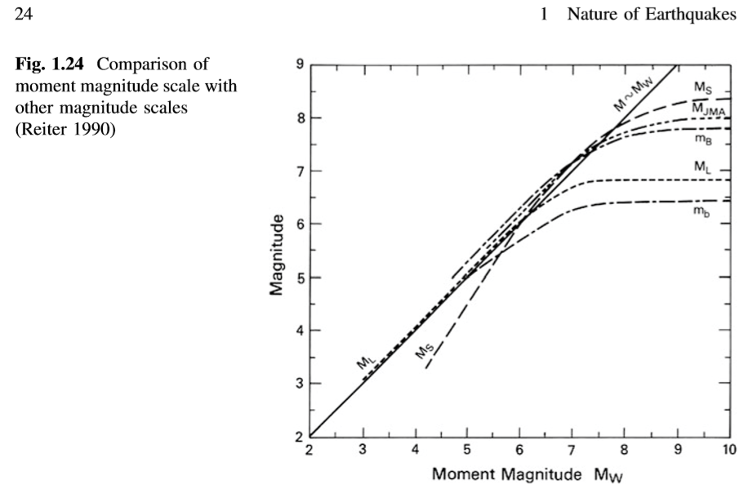

Slide 35
Intensity scales
The Modified Mercalli Intensity Scale was developed using California
buildings as its standard.
The drawback of intensity scales is that destruction may not be a true measure of the earthquake’s actual severity.
Recently,Observational Intensity is done by Grundal

Slide 38
Destruction from Earthquakes
The amount of structural damage attributable to earthquake vibrations depends on:
• Intensity and duration of the vibrations (e.g. distance from epicenter)
• Nature of the material upon which the structure rests (rock type)
• Design of structure (construction type)
Ground shaking
• Regions within 20 to 50 kilometers of the epicenter will experience about the same intensity of ground shaking.
• However, destruction varies considerably, mainly due to the nature of the ground on which the structures are

Slide 41
Earthquake destruction
Building Construction and Earthquakes –
Ground shaking versus material type –
Liquefaction of the ground ‐
Seiches ‐
Tsunamis, or seismic sea waves ‐
Landslides and ground subsidence –
Fire –
Ground Rupture ‐
Land shift –

Slide 42
E. A. Keller. Environmental Geology. Prentice Hall, Upper Saddle River, NJ, 8th edition, 2000. ISBN 0-13-022466-9.
E. A. Keller. Introduction to Environmental Geology. Prentice Hall, 3rd edition, 2005.
E. A. Keller. Introduction to Environmental Geology. Prentice Hall, 4th edition, 2008. ISBN 9780132251501. URL http://www.pearsonhighered.com/educator/academic/ product/0,3110,0132251507,00.html.

